Slide 1
GROUP - 8
Problem Statement - Designing a wearable smart device to assist elderly people in detecting falls and requesting help automatically.
61 – Prithvi
67 – Prajwal
68 – Chaitanya
69 – Krish
72 - Abdul

Slide 2
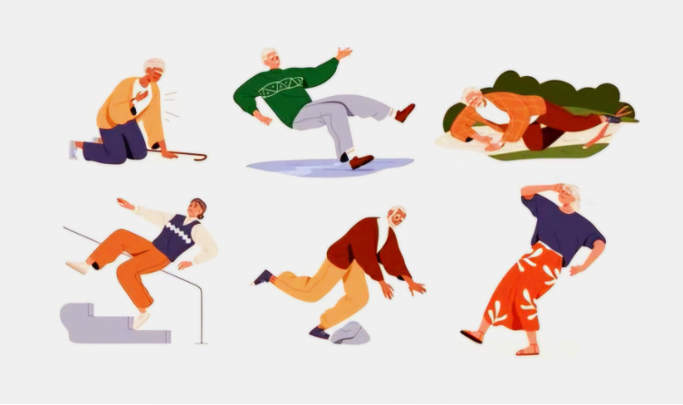
Frame 1: ​
The Fall Happens Sketch ​
Description: The frame shows an elderly man, John, walking in his living room. His left foot catches on a rug, and his body is tilting forward as he loses balance. A coffee table and couch are in the background, indicating a familiar home environment.
Context: John is going about his daily routine when he trips and falls.​
Dialogue/Thoughts: John (thinking): "Oh no! I’m falling!"
Pain Point: John is unable to prevent the fall and lands awkwardly on the floor.
Opportunity: The smart wearable needs to recognize the sudden movement (impact + position) and trigger its fall detection system.​

Slide 3
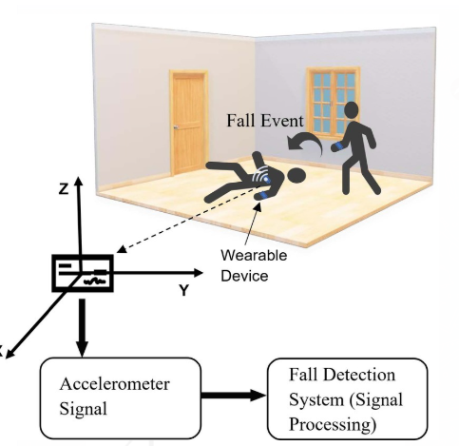
Frame 2:
Wearable Detects the FallSketch
Description: John is sitting on the floor, looking distressed. The wearable device on his wrist is vibrating and emitting a red flashing light. A small screen on the wearable displays a warning: “Fall Detected. Sending Alert in 10 Seconds…”
Context: The wearable’s sensors have detected a sudden impact and change in body position (fall). It begins a countdown to send an emergency alert to John’s contacts.
Dialogue/ Thoughts: John (thinking): "Thank goodness—it’s working. I hope someone gets the alert soon!"
Pain Point: John worries whether the alert will go through and if someone will respond.
Opportunity: Add a reassuring confirmation message: “Alert Sent Successfully” after the countdown completes.

Slide 4
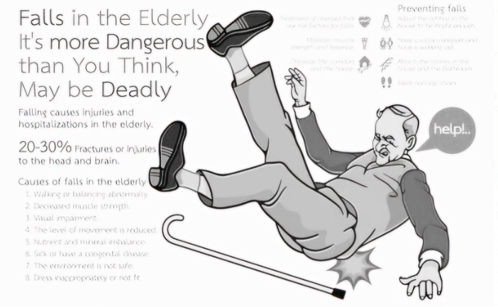
Frame 3:
Emergency Contact Receives the AlertSketch
Description: A smartphone screen is shown with a notification that reads: “Emergency Alert: John has fallen. Location: [Home Address]. Check in immediately.” The emergency contact’s face is shown holding the phone with a concerned expression.
Context: The wearable has successfully sent an alert, and the emergency contact is notified with John’s location and details.
Dialogue/Thoughts: Emergency Contact (thinking): "I need to call John and check if he’s okay."
Pain Point: The contact may miss the notification if they are busy or asleep.
Opportunity: Ensure simultaneous notifications to multiple contacts and include an option to escalate to emergency services if no one responds promptly.

Slide 5
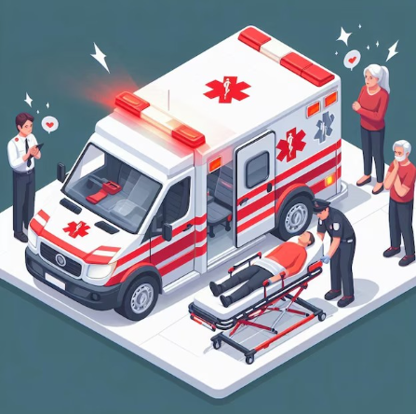
Frame 4:
Help ArrivesSketch Description: John is sitting on the couch with a paramedic kneeling beside him, holding a first aid kit. The paramedic’s expression is calm and professional, while John looks relieved. The wearable on John’s wrist is still visible, subtly glowing to show it is active.
Context: Paramedics arrived promptly after being contacted by John’s emergency contact.
Dialogue/Thoughts: John (thinking): "I’m so glad the device worked. I feel much safer now."
Pain Point: John might feel uncertain about how the system handled the emergency overall.
Opportunity:Include an incident summary sent to the app, showing a timeline of events (fall detection, alert sent, help arrived).

Slide 6
Summary for Each Frame
Frame 1: John tripping on the rug, falling mid-motion.
Frame 2: John on the floor, wearable vibrating and showing a countdown.
Frame 3: Emergency contact receiving a smartphone alert with location.
Frame 4: Paramedics helping John, wearable glowing to indicate functionality.

